Slide 1
Cybersecurity
Wireless Jamming

Slide 2

Wireless Jam

Slide 3

Wireless Signals
WiFi is digital radio signals operating at set frequencies
2.4GHz – 802.11a, 802.11b, 802.11g
5GHz – 802.11n, 802.11ac
WiFi is controlled radio signals
Complex signal: Quadrature Amplitude Modulation (QAM)
Determines bits from the amplitude and phase of signal
If signal cannot be heard, data transfer is interrupted

Slide 4
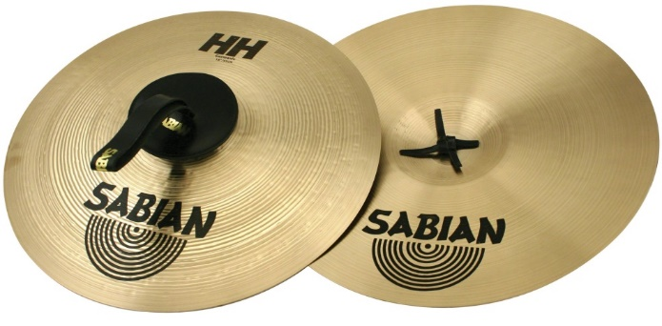
Radio Frequency (RF) Jamming
Transmitting any interfering radio signals
Example:
Imagine having a conversation with a friend, you’re exchanging ideas for a project, and making really great progress on the assignment.
Along comes someone that wants to disrupt you. You might normally be able to ignore them or speak over their distractions.
Then they pull out a pair of crash cymbals.
The conversation will stop until they stop playing the cymbals.
This individual has jammed the conversation.
Radio jamming is very similar.

Slide 5
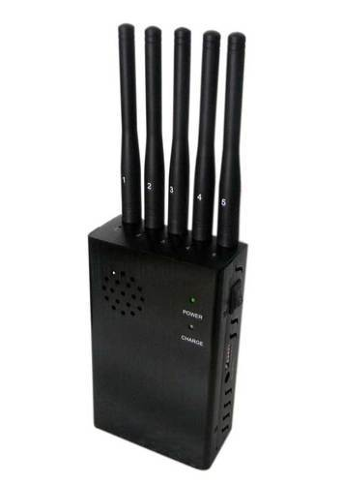
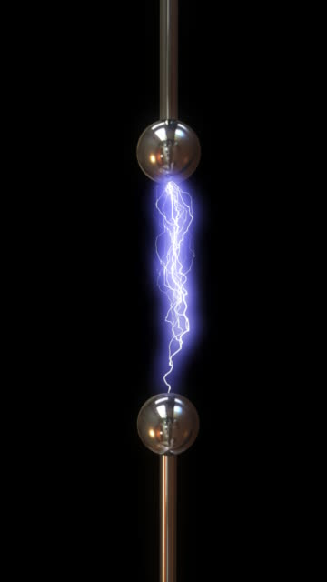
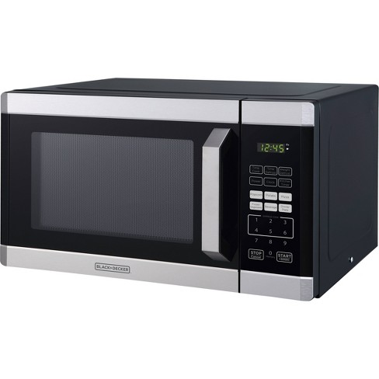
Jamming Sources
Unintentional
Referred to as interference, or RFI
Microwave oven
Fluorescent lights
Nearby cell phone towers
Licensed radio operators
Baby monitors
Electronic arcing
Intentional
Malicious individual wants to disable your network

Slide 6
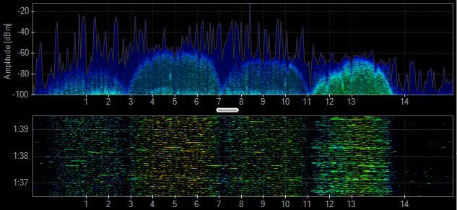
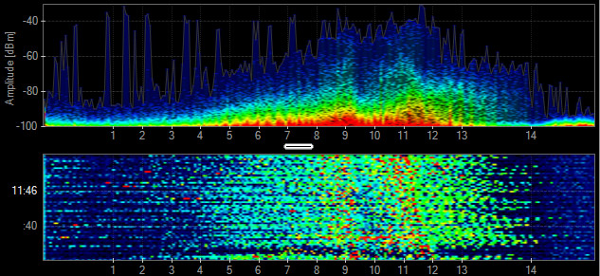
Wireless Jamming
802.11b Signal
Different modes
Constant, loud signal (likely RFI or simple jammer)
Random bits/constant
Legitimate frames
Data sent at random times
Random, nonsense data in legitimate frames
Reactive jamming
Only when target tries to communicate
Microwave Oven

Slide 7
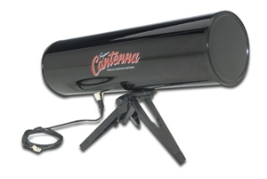

Locating the jammer
Radio “Fox hunting”
Directional antenna
Attenuator
Signal strength meter
Location
Nearby, close proximity
Someplace with electric power

Slide 8
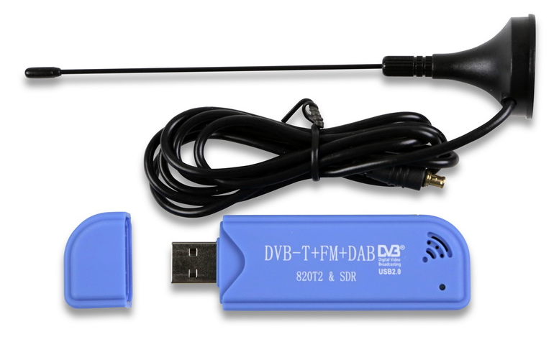
Locating the Jammer
Check for RFI
Intermittent? What appliances are in use?
Microwave
Wire/connector lose in refrigerator or HVAC
Turn off power breakers in that area until RFI stops
Offending device is on that circuit somewhere
Watch the radio signals
Make use of RTL-SDR or similar device
Tune to offending band
Watch what signals overpower wifi

